Slide 1



Patient/family-centered communication in health encounters in families with children with disabilities and/or chronic conditions
Grace Ellen Brannon, PhD
Department of Communication
University of Texas at Arlington
Notes:
Objective 1: Describe how parents/caregivers of children with disabilities and/or chronic conditions report their healthcare encounters
Objective 2: Identify disparities in patient- and family-centered care among families with children with disabilities and/or chronic conditions
Before I get into my background, I wanted to highlight an interaction I in February.

Slide 2

Background
Type 1 diabetes diagnosis (2011)
Son’s FOXE3 genetic mutation diagnosis (2019)
Son’s HIE event (2019)
Subsequent therapies

Slide 3
Introduction
Communication is central to the health-care interactions between patients, families, and clinicians (Street, 2013)
Patient-centered communication (PCC) can affect health outcomes (Arora, 2003; Street et al., 2009)
PCC breakdowns cause distress and worsen patient experiences (Street at al., 2019)

Slide 4
Introduction
Preventative cautions of COVID-19 and limitations of healthcare providers’ services contributed to people forgoing or delaying healthcare (Beran et al., 2021; Blay et al., 2021; Gonzalez et al., 2021)
Non-modifiable factors related to forgone care (demographic background, insurance coverage and education) were explored prior to the pandemic (Burgard & Hawkins, 2014)
Modifiable factors, including the communication environment, can be a promising target for interventions to improve the healthcare conditions of disadvantaged populations
Children with special care needs may face higher risks than their healthy peers if they do not access care, resulting in delayed diagnosis, late treatment, and even death (Lazzerini, 2020)

Slide 5
Aim of Study 1
Focus on the relationship between FCC and SDM with forgone healthcare during the COVID-19 pandemic’s early days.
Explore the differences of pathways among children with mental health needs and those with physical health conditions

Slide 6
Hypotheses and Research Questions
H1: FCC is related to lower likelihood of forgone pediatric care during COVID-19.
H2: SDM is related to lower likelihood of forgone pediatric care during COVID-19.
RQ1a: How does open family communication, as facilitated by FCC, affect the likelihood to forgo pediatric care during COVID-19?
RQ2a: How does open family communication, as facilitated by SDM, affect the likelihood to forgo pediatric care during COVID-19?
RQ1b: How does parents’ satisfaction with providers’ communication, as facilitated by FCC, affect the likelihood to forgo pediatric care during COVID-19?
RQ2b: How does parents’ satisfaction with providers’ communication, as facilitated by SDM, affect the likelihood to forgo pediatric care during COVID-19?

Slide 7
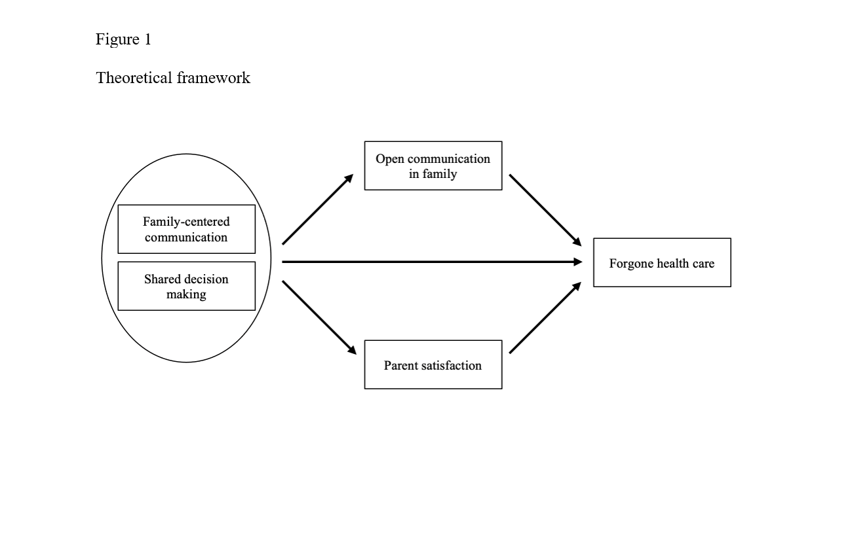

Slide 8
Methods
Data Collection
Inclusion/Exclusion Criteria: Parents (ages 0-17) who completed the NSCH survey and visited a doctor and made any medical decisions within the past 12 months (n= 10,845)
Survey Method: Paper or online questionnaire
Timeframe: NSCH July 27, 2020 – January 22, 2021
Notes:
We used nationally representative data from the 2020 NSCH funded and collected by the Health Resources and Services Administration’s Maternal and Child Health Bureau (HRSA MCHB) between July 27, 2020, and January 22, 2021. Using an address-based sample from administrative records, NSCH invited adults of US households that have children age under 18. The invitation was sent by mail, and the adult participants completed a paper or online questionnaire about their children’s health. If a household had more than one child, only one was randomly selected as the subject of the survey. As a result, 42777 surveys were collected nation-wide (42.4%), with 644 to 3039 completed per state. Each participant was randomly rewarded $2, $5, or no incentives for their participation, as NSCH ran an experimental incentive program to increase its response rate. To test the hypotheses and answer the research questions, 10845 participants who visited a doctor and made any medical decisions were included in this study.
The sample includes parents of children (ages 0-17) who completed the HRSA MCHB sample and visited a doctor and made any medical decisions (n= 10,845)

Slide 9
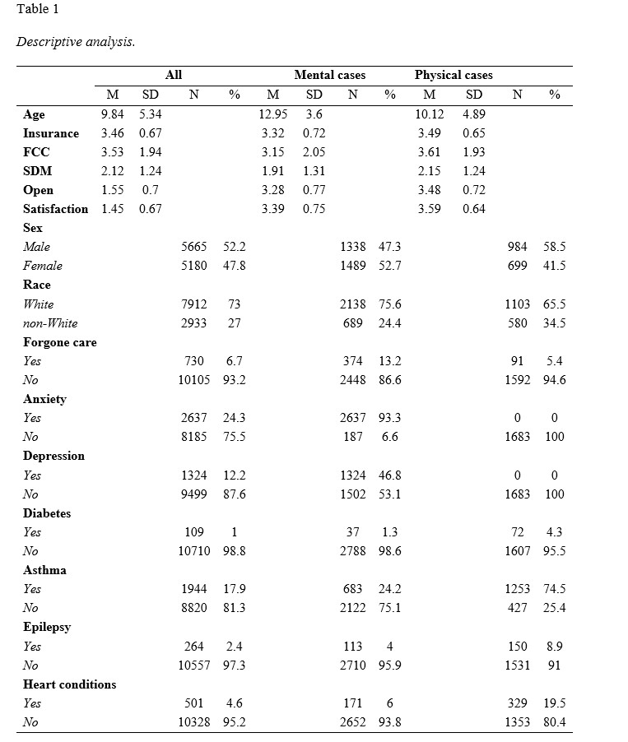
Methods
Participants

Slide 10
Notes:
Participants

Slide 11
Methods
Variables
Population: Parents of children ages 0-17 who had physical health conditions or mental health needs
IVs: FCC, SDM
Mediators: Open communication, parent satisfaction
DV: Forgone healthcare
Confounders/Other Factors: Child age, sex, race, insurance coverage, health status, and family income

Slide 12
Methods
Statistical Analysis
Descriptive Statistics: Frequencies, percentages
Comparative Statistics: Regression analysis, mediation analysis

Slide 13
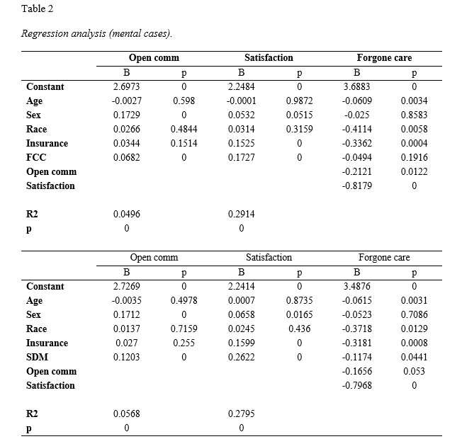
Results

Slide 14
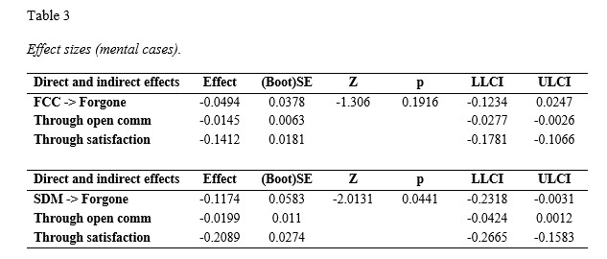
Results

Slide 15
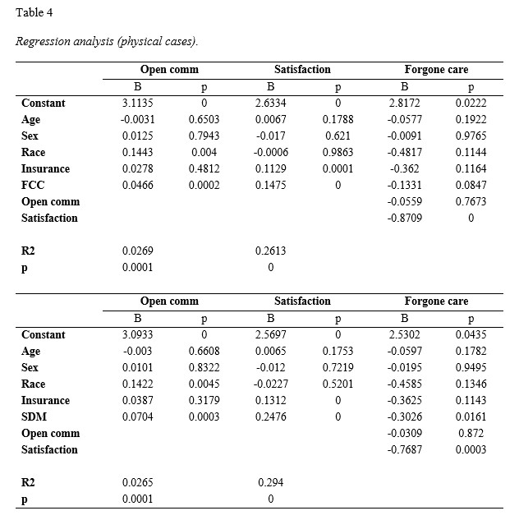
Results

Slide 16
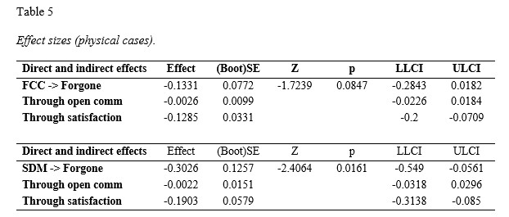
Results

Slide 17
Discussion
Less SDM and lower provider communication satisfaction were key factors associated with forgone care among parents of children with physical health conditions and mental health issues.
Findings suggest that children with mental health conditions during COVID-19 pandemic’s early days have increased frequency of forgone health care, lower FCC, lower SDM, less open communication and decreased satisfaction compared to children with physical conditions.
Children’s perspective in pediatric care should be prioritized
Non-modifiable factors play a larger role in forgone care of children with mental health issues when compared to children with physical health conditions.

Slide 18
Strengths and Limitations
Strength: Nationally representative survey of parents of children with health issues
Limitations: NSCH is not longitudinal, causality cannot be determined; single-item measurements

Slide 19
Recommendations
Health institutions should encourage and facilitate the use of MyChart or similar communication strategies to communicate with one’s health care provider.
Development of a more comprehensive understanding of the relationship between FCC, SDM, and forgone care in pediatric healthcare settings.
Further studies should focus on the disparities in race and ethnicity impacting children’s access to quality and equitable health care, use the revised Family Communication Patterns conversation orientation scale and investigate communicative domains separately.

Slide 20
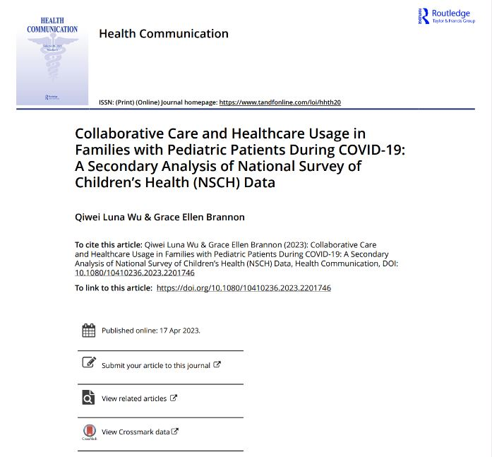

Slide 21
Background
Patient- and family-centered care (PFCC) is based on the idea that a child’s primary source of strength and support in managing care is from the family
Foundations of PFCC include parent-provider communication and collaboration between health care teams and families
Studies have evaluated parents’ perceptions of PFCC whose children have been diagnosed with special health care needs
Few studies have explored how PFCC between families whose children have developmental and chronic health conditions and those who do not, specifically among mothers

Slide 22
Objectives
To determine mothers’ perceptions of health care providers’ practice of patient- and family-centered care (PFCC) domains among those whose children have a developmental or chronic health condition
To determine associations between the presence of developmental or chronic health conditions and mothers’ reports of PFCC domains

Slide 23
Methods
Data source
2013-2017 Medical Expenditure Panel Survey (MEPS) Household and Medical Condition data
Sample
Mothers who reported visiting a health care provider for their child within the past 12 months (n=31,474)
There were 36,675 total parents (mothers = ~86%)

Slide 24
Methods
Independent variable
Combined measure of any developmental or chronic health conditions (yes or no) previously diagnosed in the child being assessed

Slide 25
Methods
Dependent variables
Separate domains of PFCC quality related to how often (always or not always) providers:
Listened carefully to the parent
Explained things in a way the parent could understand
Showed respect for what the parent had to say
Spent enough time with parent
Likert scale responses (never, sometimes, usually, always) recoded to binary (always, “not always”) variable

Slide 26
Methods
Chi squares used for bivariate analysis
Logistic regression used to evaluate odds of receiving PFCC using a dichotomous measures of each separate domain
STATA SVYSET procedures used for complex sample

Slide 29
Conclusions
Mothers whose children had developmental or chronic health conditions had lower odds of reporting their health care provider demonstrated PFCC
Efforts to improve PFCC should focus on training providers to establish high quality practices to improve health outcomes for pediatric patients with developmental or chronic conditions

Slide 30
Next Steps
Conduct multivariable analyses to adjust for child and parent characteristics
Expand research to use linked National Health Interview Survey (NHIS) and MEPS data to capture other health conditions not available using only MEPS data source

Slide 31
Contact: Tiffany.Kindratt@uta.edu
Twitter: @tbkindratt; Lab Website: https://hsrlab.uta.edu/
List of Additional Authors
Payton Lark, Mattie Ray, Grace E. Brannon, PhD
Acknowledgements
This study was supported by a grant from the 2020-2021 University of Texas at Arlington, Research Enhancement Program

Slide 32
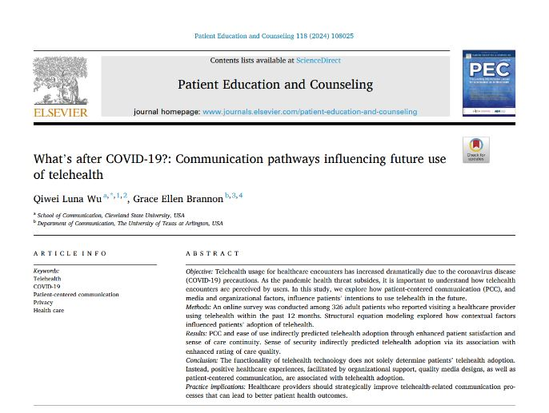
Extra Paper – Did not Discuss

