Slide 1
Does Geographically Adjusting Poverty Thresholds Improve Poverty Measurement and Program Targeting? Poverty and Well-being in West Virginia and Elsewhere Bruce D. Meyer, University of Chicago, NBER, and AEI Derek Wu, University of Chicago Brian Curran, University of Chicago
West Virginia University School of Medicine, Grand Rounds
May 11, 2021
Disclaimer: This presentation, which has been subject to a limited review, is released to inform interested parties of research and to encourage discussion. The views expressed are those of the authors and not those of the U.S. Census Bureau. All results were approved for release by the Census Bureau’s Disclosure Review Board, authorization numbers CBDRB-FY20-ERD002-020 and CBDRB-FY21-ERD002-002.
Notes:
Joint with Derek Wu, and Brian Curran. Not the views of the U.S. Census Bureau. We welcome suggestions as this is new work

Slide 2
Motivation
Prices differ greatly across geography
Fixed market basket of good (e.g., two-bedroom apartment) costs more in New York City than in rural West Virginia
Should poverty thresholds therefore be adjusted to reflect geographic differences in cost-of-living? Should the income cutoff for government transfer payments be similarly adjusted?
Policy implications can be enormous
A geographic adjustment would classify fewer (more) people as poor in lower (higher) cost areas
The Official Poverty Measure (OPM), which does not have a geographic adjustment, is used to determine eligibility for government programs, allocate government funds, and guide policies
Notes:
I am going to focus on how we decide who is classified as poor. You should think of the same numbers as deciding who is eligible for benefits,.
Bills have been proposed in Congress recently to adjust poverty line for a notion of local costs. Or maybe more importantly, there is an active political debate about what geographic areas are most in need of government support—this is on the table now in proposals by Biden. Should places like Huntington WV that have seen declining population get special government support. Nice NYT piece a couple of days ago.
We should discuss the last bullet. The setting of reimbursement rates like FMAP (which is based on per capital income) is a related but different issue.
Programs with funds allocated geographically based on local poverty rates include HUD’s Community Development Block Grants/Entitlement Grants Program and DOT’s Job Access-Reverse Commute Program (Reamer 2010).

Slide 3
Geographic Adjustments in Current Policies
Census Bureau’s Supplemental Poverty Measure (SPM) adjusts thresholds for geographic differences in rental prices
Many people have proposed geographic adjustments for the Official Poverty Measure (OPM)

Slide 4
Economic Theory Implies a Geographic Adjustment May Be Counterproductive
Long literature in economics suggests that spatial differences in prices reflect local characteristics
See, e.g., Tiebout (1956), Rosen (1974), Haurin (1980), Roback (1982)
Thus, spatial variation in housing prices may simply reflect variation in locational desirability (i.e., amenities) and is likely accompanied by changes in wages and other factors

Slide 5
Research Points to Accounting for Both Prices and Amenities
Research proposes that one should value amenities and sum up differences in prices and amenities by geography
See Roback (1982), Gyourko and Tracy (1991)
Local school quality and environmental conditions have been shown to be associated with house prices
Wages, the generosity of safety net programs, and other government spending are strongly associated with prices
Long literature indicates that this is difficult to implement
Recent summary in Greenstone (2017): omitted variables, average v. marginal

Slide 6
Our Framework
Assesses desirability of a geographic poverty adjustment by examining how well it identifies most disadvantaged
High-level goal is to determine who is disadvantaged
Policy use of current measures includes determining most disadvantaged to allocate funds and target programs at geographic and individual level

Slide 7
Plan
Empirical Evidence
Refers to other parts of the larger research project that I will only briefly explain
Explanations for our results
Correlations of local characteristics with prices
Notes:
We should discuss the last bullet. The setting of reimbursement rates like FMAP (which is based on per capital income) is a related but different issue.
Programs with funds allocated geographically based on local poverty rates include HUD’s Community Development Block Grants/Entitlement Grants Program and DOT’s Job Access-Reverse Commute Program (Reamer 2010).

Slide 8
Summary
This paper compares nine categories of material well-being measures among those added to and removed from poverty by a geographic adjustment
Examines two poverty measures: survey-based SPM and a new Comprehensive Income Poverty Measure (CIPM) that links survey and admin. data to better measure incomes
Seventh project to come out of Comprehensive Income Dataset (CID) Project
Links most of the major Census surveys to IRS tax records and program data from many federal agencies and states
Key result: Incorporating a geographic adjustment consistently identifies a less deprived population
Notes:
We could expand on the first bullet.
Relevant to determine deprivation for purposes of targeting.
Researchers and the public generally care about poverty because it is related to other measures of deprivation.

Slide 9
Data Sources

Slide 10
Survey Data
Focus on reference year 2010
2011 Current Population Survey (CPS ASEC)
Source of official income and poverty estimates
2008 SIPP Panel (surveyed people through 2013)
Survey with most comprehensive income information
Sample from reference month 4 of Wave 6 (spanning April-July 2010)
Combine information from Waves 5-8 to calculate annual income for 2010
Pull in additional well-being outcomes from Waves 4, 6, and 7

Slide 11
Administrative Data

Slide 12
Linking Survey and Administrative Data
Link survey and administrative data by Protected Identification Key or PIK
PIK rates over 99% in most admin records
PIK rates at sharing unit level over 90% in both surveys
SIPP: Keep sharing units with at least one PIKed member
CPS: Keep sharing units with at least one PIKed member and no whole imputes
Adjust for incomplete PIKing through weighting
Notes:
We link survey and admin data by PIK which you can think of as an anonymized version of the SSN, but it fact it is based on probabilistic linking
In both surveys we keep families with at least one linkable (PIKed) family member, in CPS only families in which no one is whole imputed
We adjust for incomplete PIKing (as well as whole imputes in the CPS) using inverse probability weighting at the family level
Family linking reduces selection issues and, for several programs, we can link based on one PIKed family member because all members are in the admin data
However, we will miss admin dollars for un-PIKed individuals in PIKed families if the source is received at the individual level like earnings, Social Security, pensions etc.
What we do then is to continue using survey values for income sources where the admin data are at the individual level (but if survey values are under-reported, we’re still going to understate the value of these income sources)

Slide 13
Construction of Poverty Measures

Slide 14
Supplemental Poverty Measure (SPM)
Resource Measure (from survey):
Pre-tax money income + in-kind transfers – expenses/taxes
Poverty Threshold:
t = housing tenure, a = # adults, c = # children, s = state, m = MSA
E = equivalence scale for two-adult, two-child sharing unit
MRI = median rent index (median gross rent for 2-bedroom unit in geographic area divided by national median for same unit type)
Notes:
MRI, what Census currently uses for the SPM, only accounts for housing.
Will also use RPPs that account for 200 items in 8 broad categories rather than just housing

Slide 15
Comprehensive Income Poverty Measure (CIPM)
Resource Measure (from survey and admin. data):
Pre-tax money income + in-kind transfers + asset flows (from home, car, & other assets) – taxes
Note that we can only incorporate asset flows in SIPP
Poverty Thresholds: Same as SPM, except we no longer vary thresholds by housing tenure
No longer need to implicitly account for differences in available resources because we explicitly account for flow value of home ownership in resource measure

Slide 16
Additional Methods
To construct the SPM and CIPM without a geographic adjustment, we simply remove the geographic adjustment factor from the thresholds
For both the SPM and CIPM (with and without a geographic adjustment), we proportionately adjust thresholds so that the poverty rate is always fixed at 15.1% (equal to OPM in 2010)

Slide 17
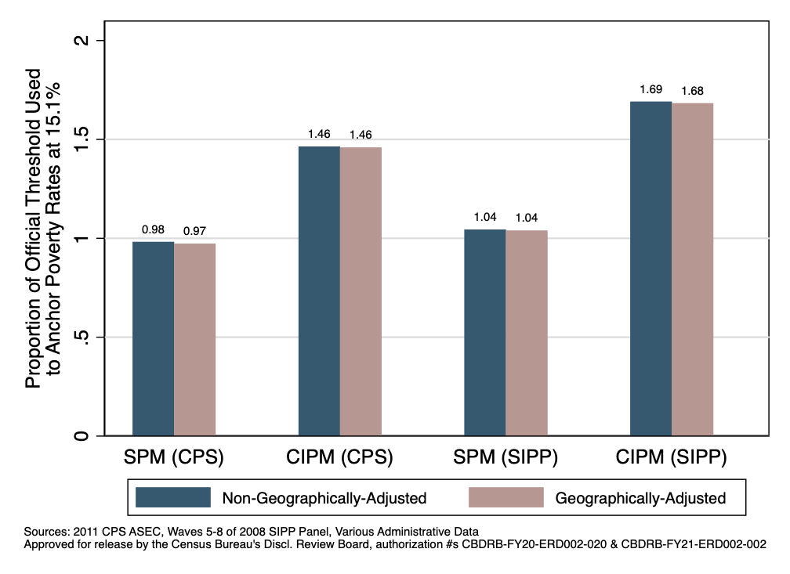
Proportions of OPM Threshold Used to Anchor Poverty Rates at Official Level (15.1%)

Slide 18
Changes in Poverty Rates with a Geographic Adjustment

Slide 19
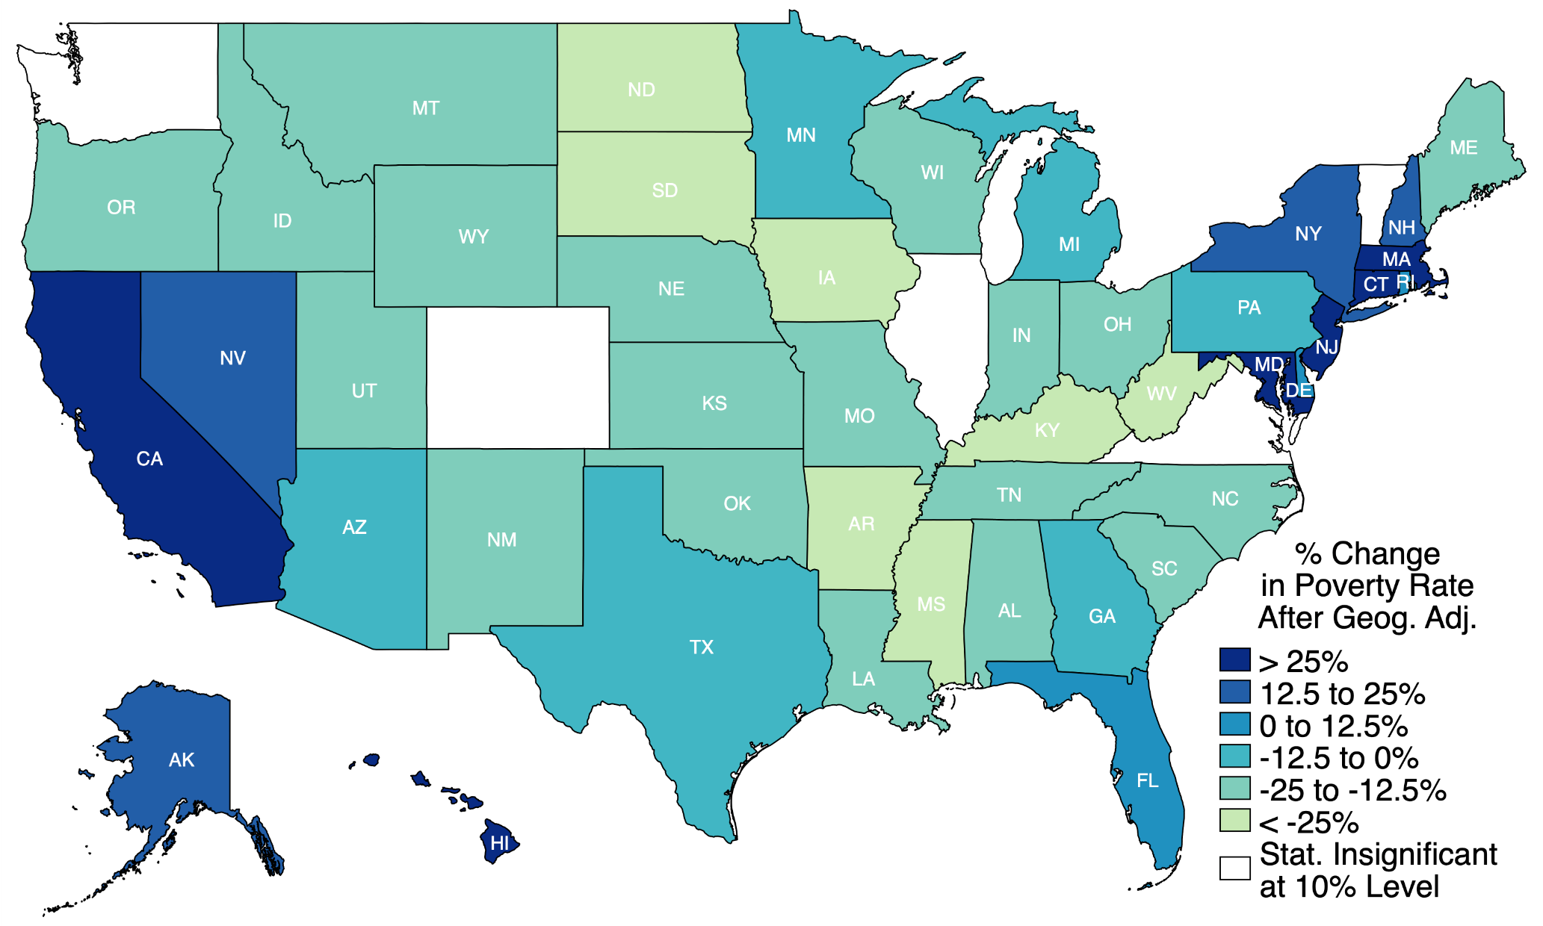
Percent Change in Poverty Rate After Applying a Geographic Adjustment (by State)
Source: 2010-2012 CPS ASEC (Public-Use); Supplemental Poverty Measure

Slide 20
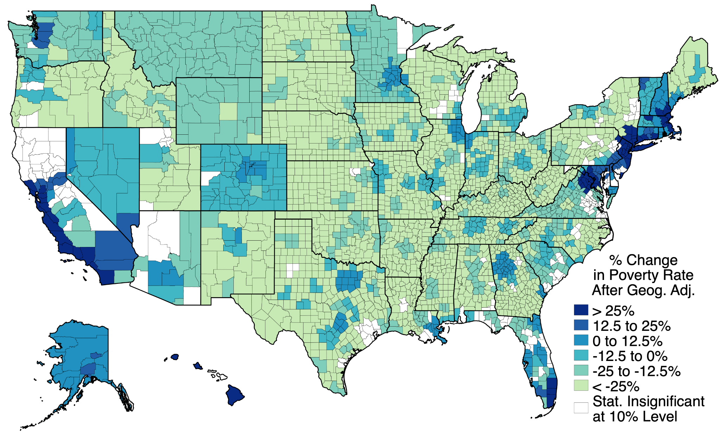
Percent Change in Poverty Rate After Applying a Geographic Adjustment (by CBSA)
Source: 2010-2012 CPS ASEC (Public-Use); Supplemental Poverty Measure

Slide 21
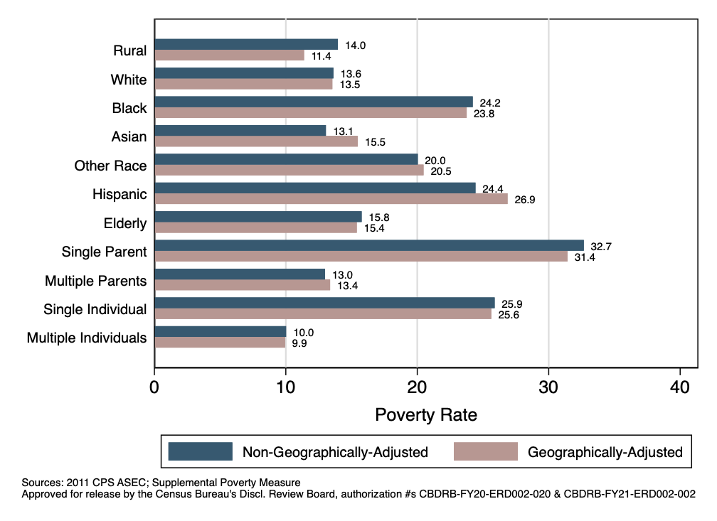
Poverty Rates with and without a Geographic Adjustment by Sharing Unit Characteristics

Slide 22
Methods to Compare Well-Being Across Poverty Measures

Slide 23
Measures of Well-Being in CPS & SIPP
Permanent income
Sum of income from tax records for 2008, 2009, 2011, 2012
AGI if filed Form 1040
Wages from Form W-2 and retirement income from Form 1099-R if did not file Form 1040
Mortality
Indicators for having died by December 31, 2015 and by March 1, 2019
Years of education (for head of sharing unit)

Slide 24
Measures of Well-Being for SIPP Only
Health problems
Fair/poor health quality (head, any individual), health condition limits work, health condition prevents work
Material hardships
Not meeting all essential expenses, not paying full rent, being evicted, not paying full energy bill, energy service disrupted, phone service disconnected, could not see doctor, could not see dentist
Home quality problems
Pests, leaking roof, broken windows, electrical problems, plumbing problems, holes in wall, holes in floor
Appliance ownership
Microwave, dishwasher, air conditioning, television, computer, washing machine, dryer, cell phone
Assets
Net worth, total wealth, total debt, home equity, vehicle equity, other assets
Food security problems
Not enough food, food did not last, meals not balanced, children not eating enough, skipped meals, ate less than one should, did not eat during day

Slide 25
Regression Specification
We estimate the following regression:
Reference group = those who are poor without a geographic adjustment but not poor with a geographic adjustment
Control for age, age-squared, gender, marital status, unit type, and race/ethnicity
Sample consists of sharing unit heads for most outcomes (weighted using head weights multiplied by sharing unit size)
Use linear model or probit to estimate regressions
Goal of regression is to compare individuals whose poverty status changes when switching between measures with and without geographic adjustments
Relevant coefficient is therefore β₁

Slide 26
Shares and Counts by Geographic Poverty Category
Notes:
May want to produce table for RPPs as well.

Slide 27
Main Results

Slide 28
Well-Being of Those Added to Poverty Relative to Those Removed with a Geographic Adjustment, SPM
Notes:
Results for health condition that limits work
Health condition that prevents work

Slide 29
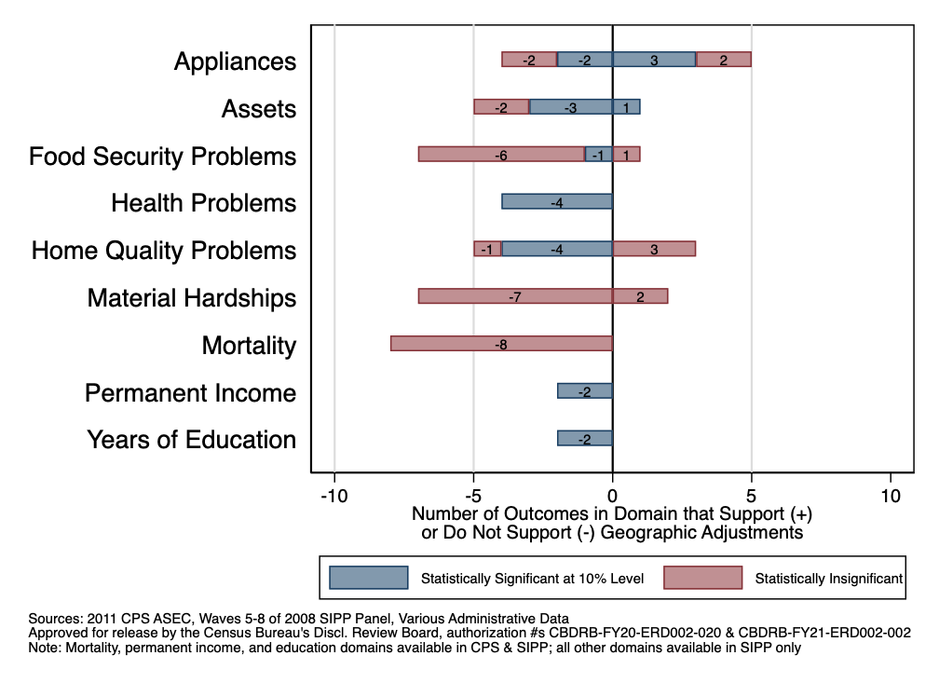
Number of Outcomes for Which a Geographic Adjustment Identifies More Deprived Population: SPM

Slide 30
Well-Being of Those Added to Poverty Relative to Those Removed with a Geographic Adjustment, CIPM

Slide 31
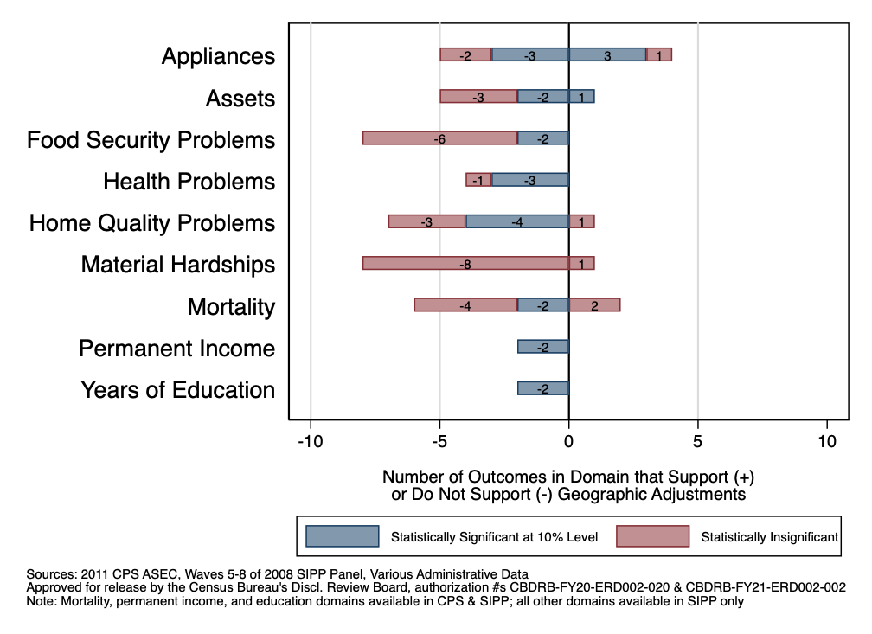
Number of Outcomes for Which a Geographic Adjustment Identifies More Deprived Population: CIPM

Slide 32
Robustness Check: Estimates with a Partial Price Adjustment

Slide 33
Overview
We now examine the effects of scaling the geographic adjustment factor (towards 1) by fractions from 0.1 to 1.0
If areas with higher rents also have higher amenities, then a full adjustment for geographic rent differences would over-adjust thresholds for well-being differences
At best, a rough approach to moderate the geographic adjustment factor to account for amenities
Fewer observations will switch in or out of poverty at lower fractions
Focus on permanent income and years of education
Available in both CPS and SIPP
Have substantial variation, allowing for greater statistical power
Focus on CIPM, although results using SPM are similar

Slide 34
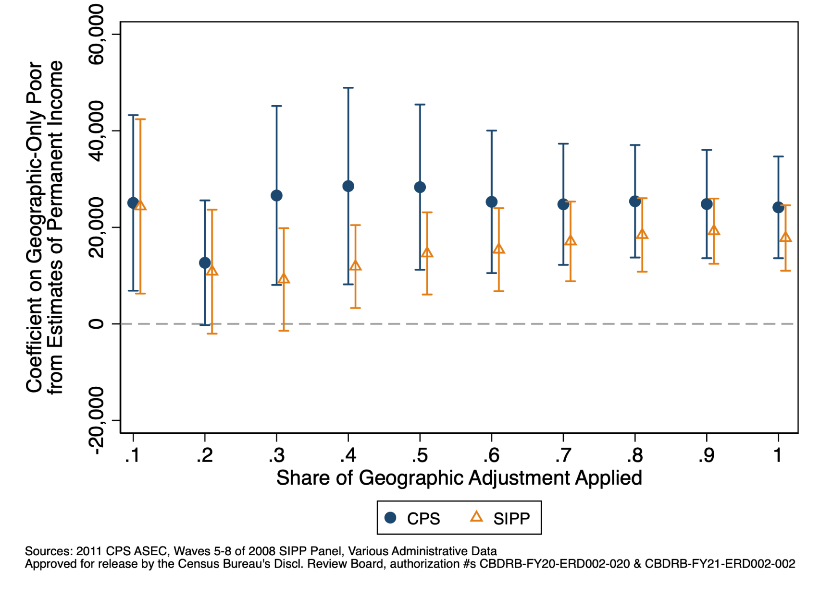
Effects for Permanent Income by Adjusted Share, CIPM

Slide 35
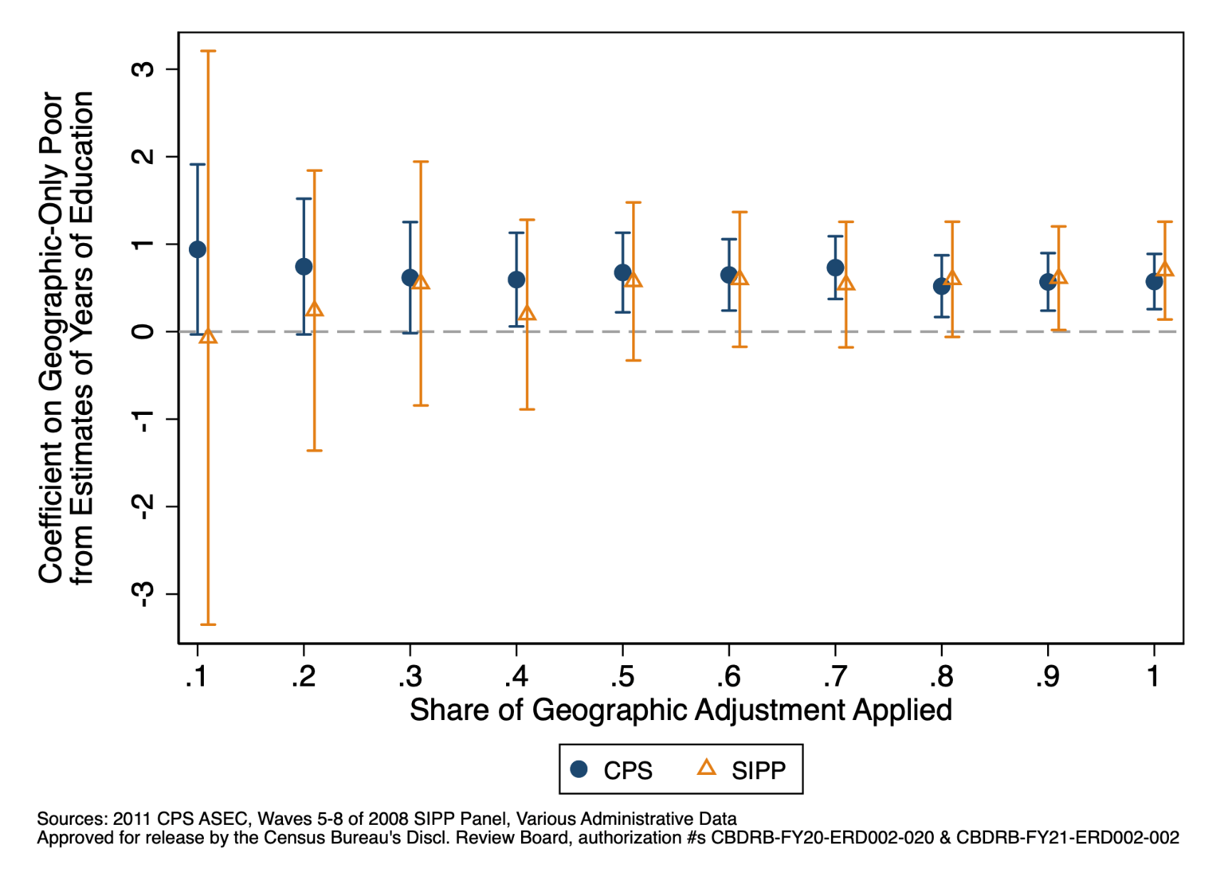
Effects for Years of Education by Adjusted Share, CIPM

Slide 36
Robustness Check: Estimates Using Regional Price Parities

Slide 37
Overview
We now examine the robustness of our results to an alternative geographic price index: Regional Price Parities (RPPs)
Rather than focusing only on rental costs (as MRI does), RPPs reflect variation in prices across housing, transportation, food, education, recreation, medical, apparel, and other goods
Replace the original geographic adjustment factor in the poverty thresholds with the RPP
Using the RPP-adjusted thresholds, we compute and anchor poverty in the same way as before
Results using SPM and CIPM
Focus on outcomes where “less is better” (e.g., mortality), but broad patterns apply to outcomes where “more is better” (e.g., assets)

Slide 38
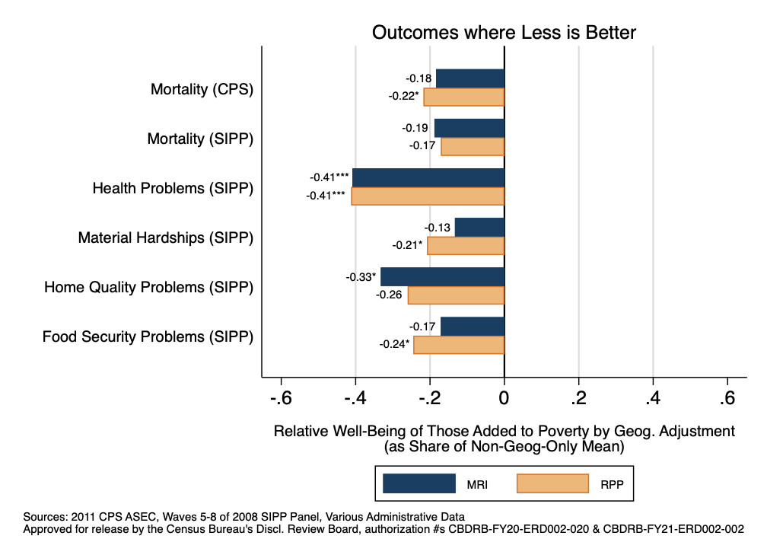
Well-Being of Those Added to Poverty Relative to Those Removed by Geog. Adjustment, Expressed as Share, SPM
Notes:
Indications of significance or precision?

Slide 39
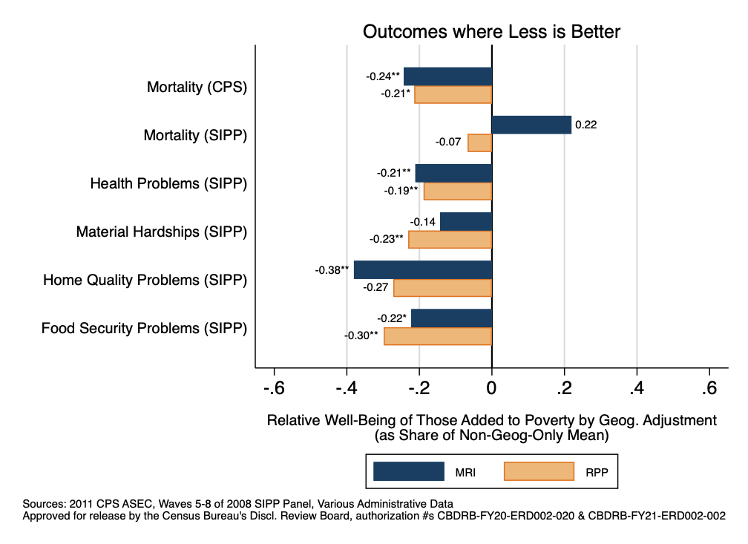
Well-Being of Those Added to Poverty Relative to Those Removed by Geog. Adjustment, Expressed as Share, CIPM

Slide 40
Robustness Check: Estimates for Deep and Near Poverty

Slide 41
Overview
Finally, we examine the effects of a geographic adjustment (relying again on MRI) on the deprivation of those in deep poverty and near poverty
Deep poverty = having incomes below 50% of poverty line
Near poverty = having incomes below 150% of poverty line
Anchor deep poverty rates to 6.7% and near poverty rates to 24.6%
Based on rates calculated in the CPS (using survey-reported pre-tax money income and official thresholds) for 2010
Show results using SPM and CIPM
Focus on outcomes where “less is better” (e.g., mortality), but broad patterns apply to outcomes where “more is better” (e.g., assets)

Slide 42
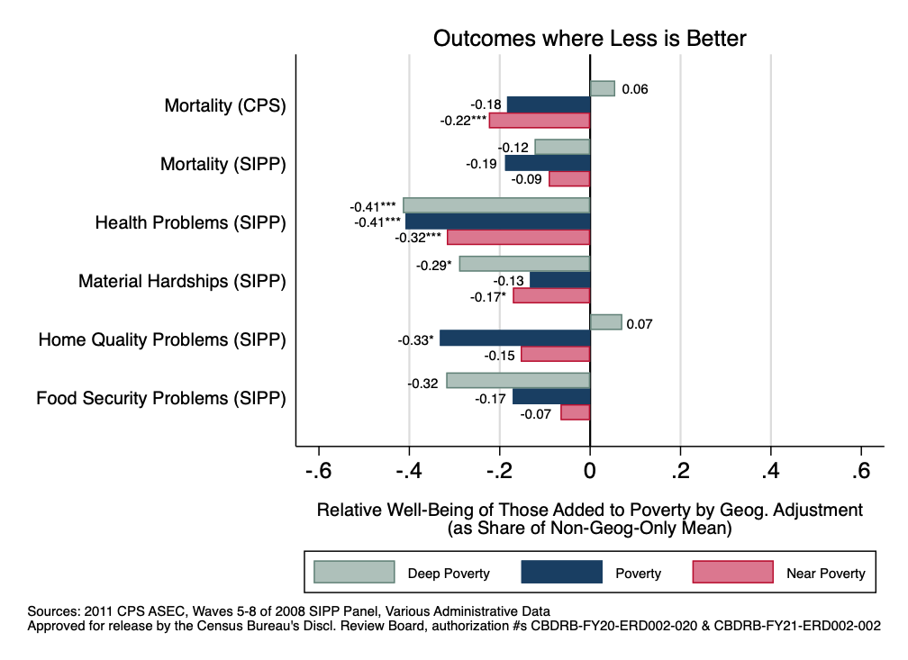
Well-Being of Those Added to Poverty Relative to Those Removed by RPP Adjustment, Expressed as Share, SPM

Slide 43
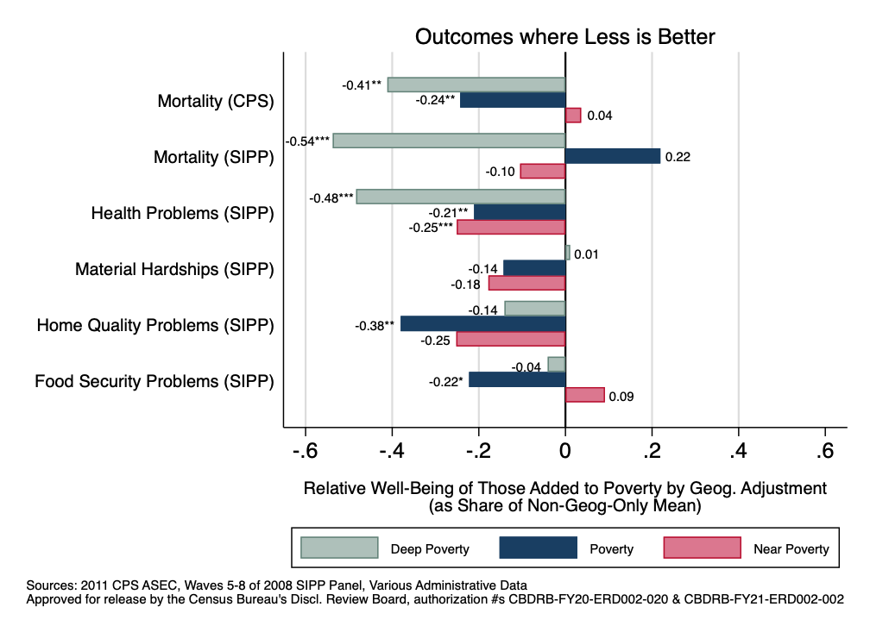
Well-Being of Those Added to Poverty Relative to Those Removed by RPP Adjustment, Expressed as Share, CIPM

Slide 44
Explanations for Results

Slide 45
Wage and Non-Wage Income Sources
Elasticities of Wage and Non-Wage Income with Respect to Price Indices, 2010 CPS Income Data
Outcome | Elasticity of Outcome with Respect to MRI | Elasticity of Outcome with Respect to RPP
 | (1) | (2)
Hourly Wage | 0.874*** | 1.072***
Social Security Retirement and Survivors Income Per Person 62+ | 0.160 | 0.199*
Social Security Retirement Income Per Person 62+ | 0.296** | 0.396***
Social Security Disability Income Per Capita | -2.173*** | -2.151***
Retirement Income Per Person 60+ | 1.369*** | 1.381***
Survey SNAP Per Capita | -2.461*** | -2.972***
Housing Assistance Per Capita | 3.643*** | 3.304***
SSI Per Capita | -0.252 | -0.452
Observations | 341 | 341
Unit of Analysis | CBSA | CBSA
Notes: This table shows the coefficients from regressions of the natural log of various income sources on the natural log of local prices calculated using either the MRI or the RPP. For wages, we use the 2011 CPS ASEC, for individuals ages 18-64 with a high school degree or less and weight the average using survey weights. We calculate per capita outcomes as the weighted total of an outcome divided by the weighted population. Housing assistance is drawn from the Census Bureau's SPM Research File. Both the MRI and RPP are calculated for calendar year 2010. In column (1), we use 0.618 + 0.382*MRI as the price index to make the results comparable where 0.382 is the housing share of consumption found using the Consumer Expenditure Survey (CE). *** p < 0.01, ** p < 0.05, * p<0.1.

Slide 46
State and Local Spending Per Capita
Elasticities of Per Capita State Spending with Respect to Price Indices, 2012 Data
Outcome | Elasticity of Outcome with Respect to MRI | Elasticity of Outcome with Respect to RPP
 | (1) | (2)
State and Local Spending
Welfare | 1.200** | 1.256**
K-12 Education | 1.206** | 1.363***
Higher Education | -1.04 | -0.852
All Education | 0.671** | 0.840***
Health and Hospitals | -0.591 | -0.668
Police | 1.800*** | 1.901***
Environment, Housing | 1.773*** | 1.937***
Other Spending | 3.716*** | 3.871***
Observations | 51 | 51
Unit of Analysis | State | State
Notes: This table shows the coefficients from regressions of the natural log of per capita spending on the natural log of local prices, calculated using both the MRI and the RPP. We obtain per capita state-level spending for fiscal year 2012 from Gordon et al. (2012). Both the MRI and RPP are calculated for calendar year 2012. In column (1), we use 0.618 + 0.382*MRI as the price index in order to make the results comparable. 0.382 is the housing share of total expenditures in the Consumer Expenditure Survey (CE). *** p < 0.01, ** p < 0.05, * p<0.1.

Slide 47
Conclusions

Slide 48
Summary of Results
We find that those classified as poor with a geographic adjustment appear to be less deprived than those classified as poor without a geographic adjustment
Urban v. rural distinction appears be key between groups
Results are strikingly consistent across a variety of settings and specifications:
8 out of 9 broad domains of well-being outcomes
Two poverty measures (SPM and CIPM) in two separate surveys (CPS and SIPP)
Partial adjustments that scale the geographic adjustment factor by different weights (to crudely account for amenities)
Regional Price Parities as alternative index
Deep and near poverty

Slide 49
Broader Implications and Next Steps
Results are directly relevant to efforts that seek to incorporate geographic cost-of-living differences into official poverty measures
Proposed by many stakeholders
Would transform face of poverty and have potentially enormous ramifications for allocation of anti-poverty funding
Also relevant to geographic benefit level variation
In future work, one could:
Use more years of data (to increase statistical power and examine generalizability to other time periods)
Bring in other indicators of well-being (e.g., mobility)
Key contribution of this paper: identifying and using wide array of well-being outcomes in survey and admin data to evaluate modifications to poverty measure
Can use these outcomes to validate other changes to poverty measure and assess targeting of government programs

Slide 50
Thank you!
bdmeyer@uchicago.edu
derekwu@uchicago.edu
brian.s.curran@gmail.com

Slide 51
Appendix Materials

Slide 52
Relative Well-Being of Those Added to Poverty with a RPP Adjustment (Relative to Those Removed), SPM

Slide 53
Relative Well-Being of Those Added to Poverty with a RPP Adjustment (Relative to Those Removed), CIPM

Slide 54
Relative Well-Being of Those Added to Deep Poverty with a Geog. Adjustment (Relative to Those Removed), SPM

Slide 55
Relative Well-Being of Those Added to Deep Poverty with a Geog. Adjustment (Relative to Those Removed), CIPM

Slide 56
Relative Well-Being of Those Added to Near Poverty with a Geog. Adjustment (Relative to Those Removed), SPM

Slide 57
Relative Well-Being of Those Added to Near Poverty with a Geog. Adjustment (Relative to Those Removed), CIPM

Slide 58
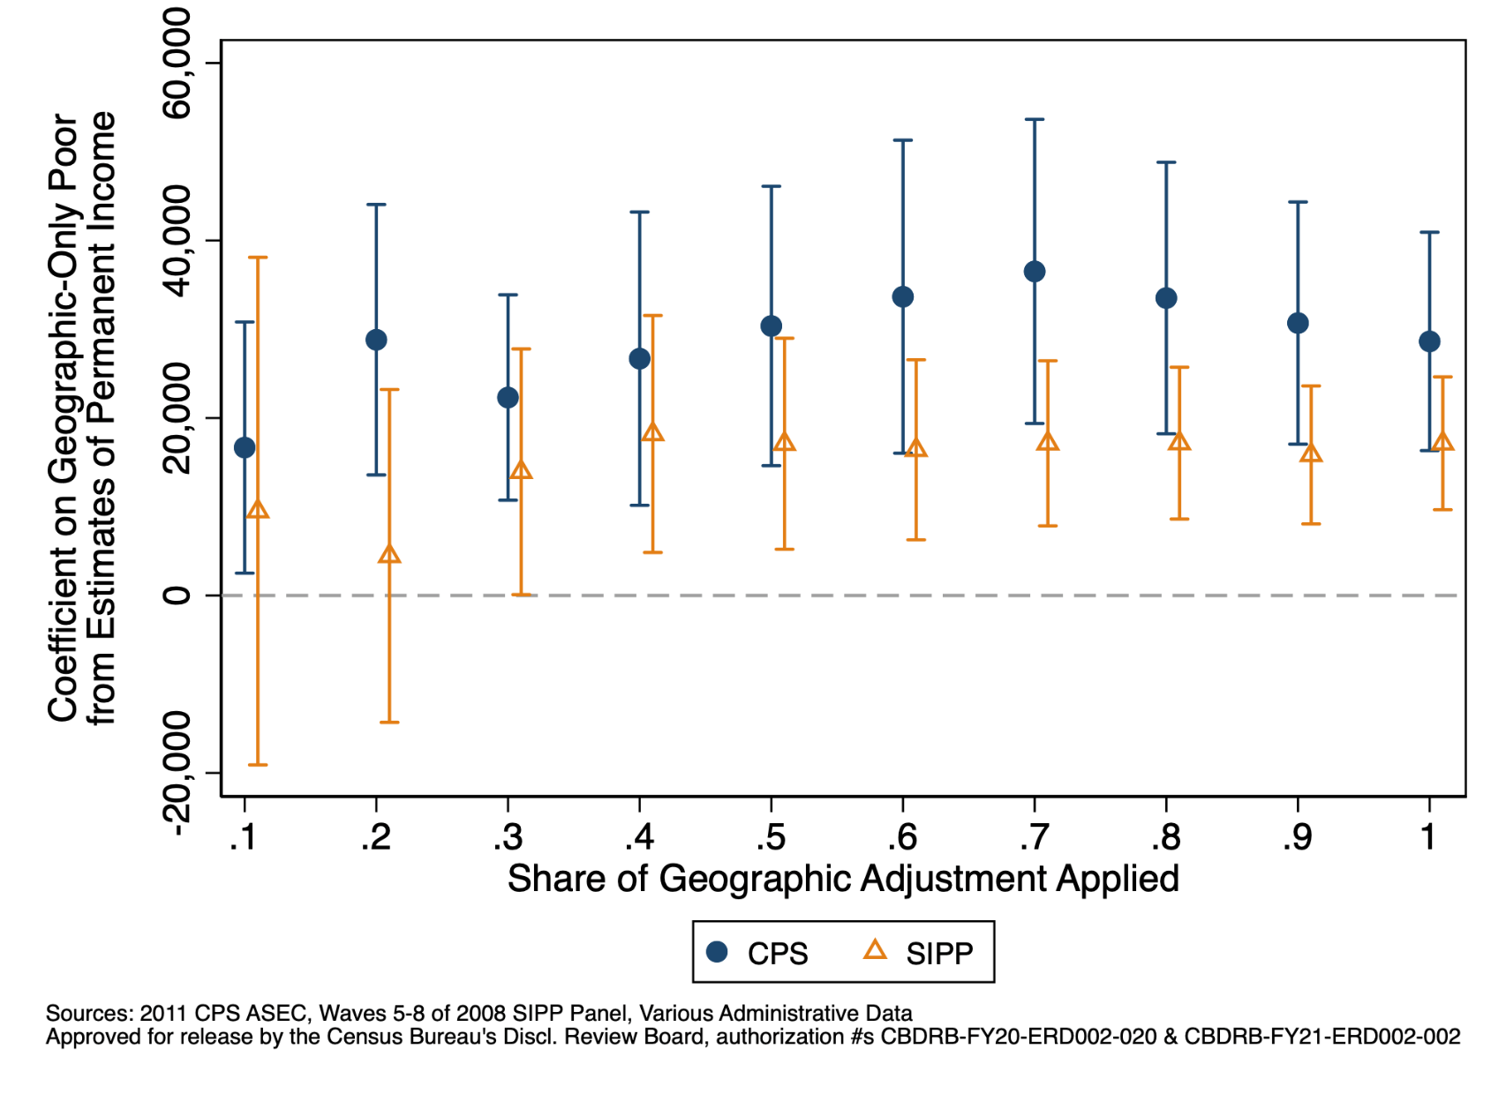
Effects for Permanent Income by Adj. Share, SPM

Slide 59
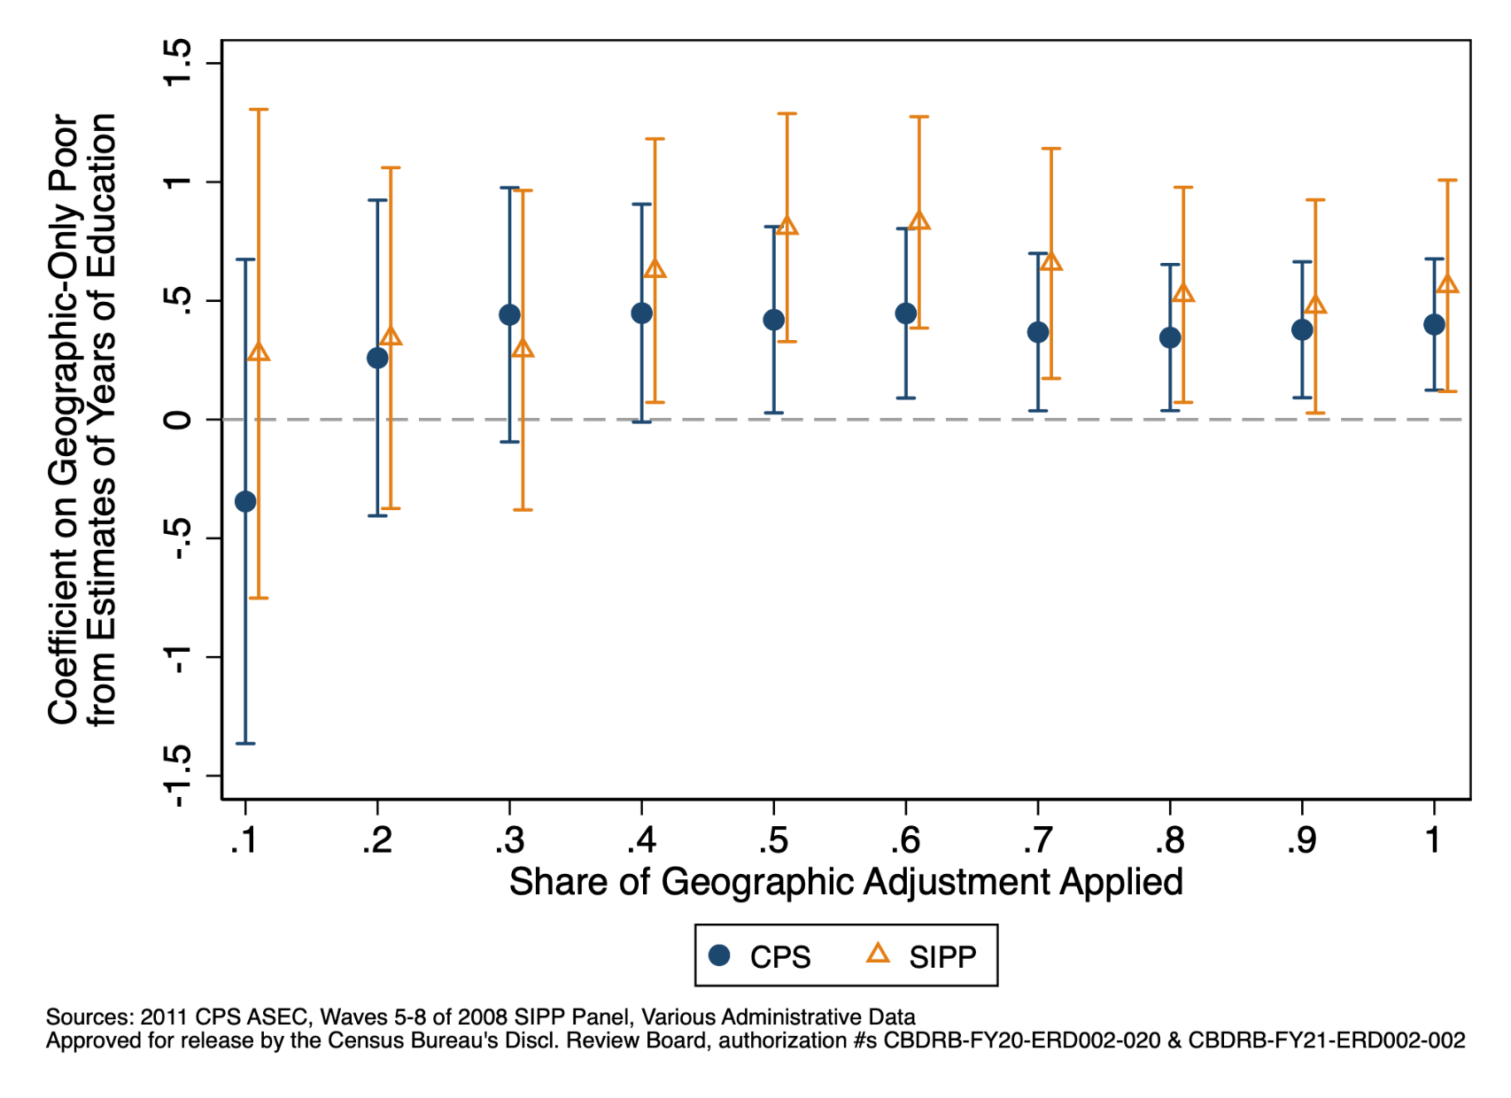
Effects for Years of Education by Adj. Share, SPM

Slide 60
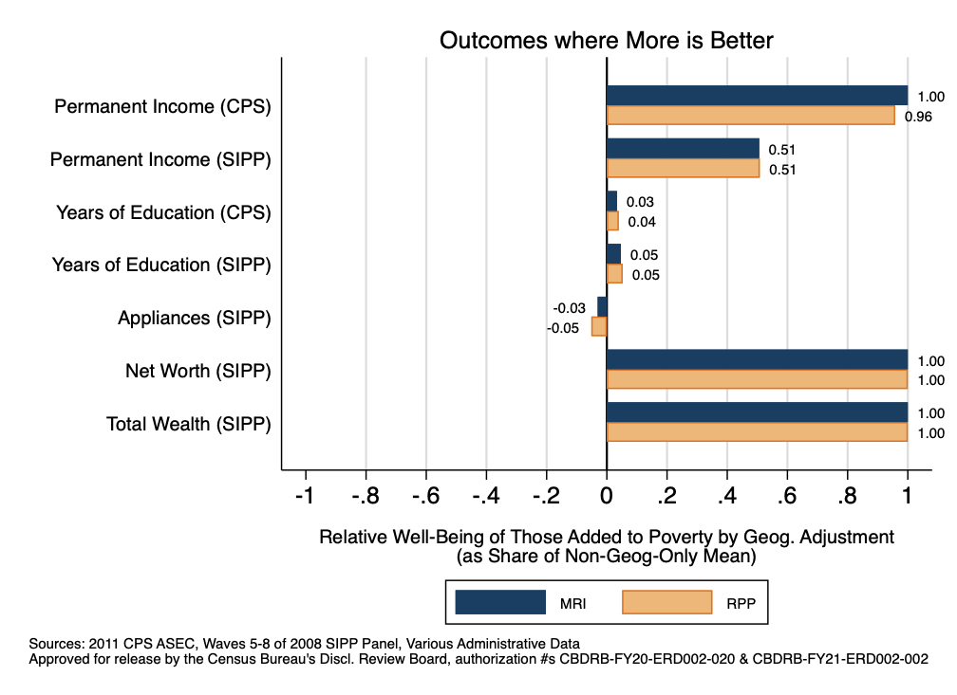
Well-Being of those Added to Poverty Relative to those Removed by RPP Adjustment, Expressed as Share, SPM

Slide 61
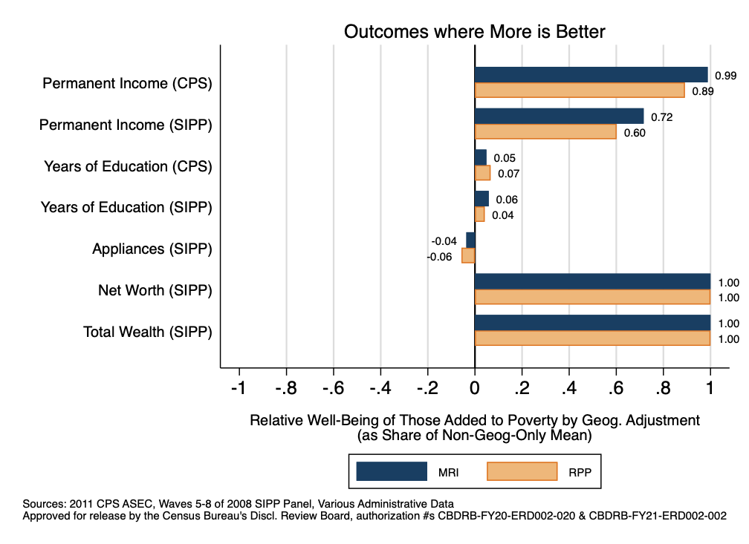
Well-Being of those Added to Poverty Relative to those Removed by RPP Adjustment, Expressed as Share, CIPM

Slide 62
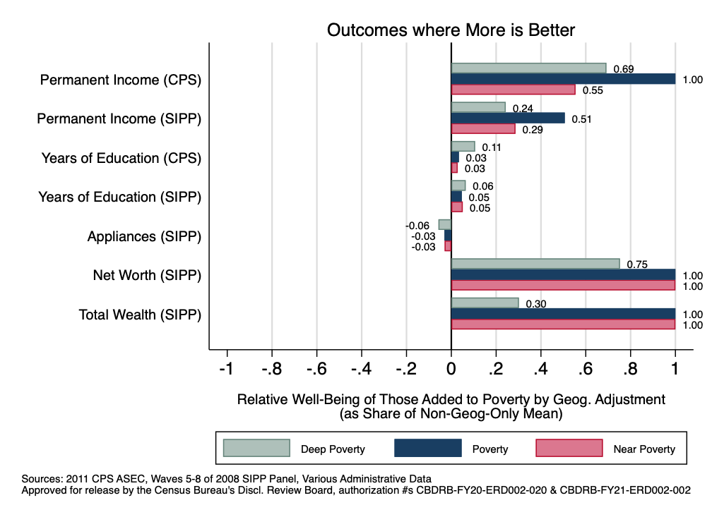
Well-Being of those Added to Poverty Relative to those Removed by RPP Adjustment, Expressed as Share, SPM

Slide 63
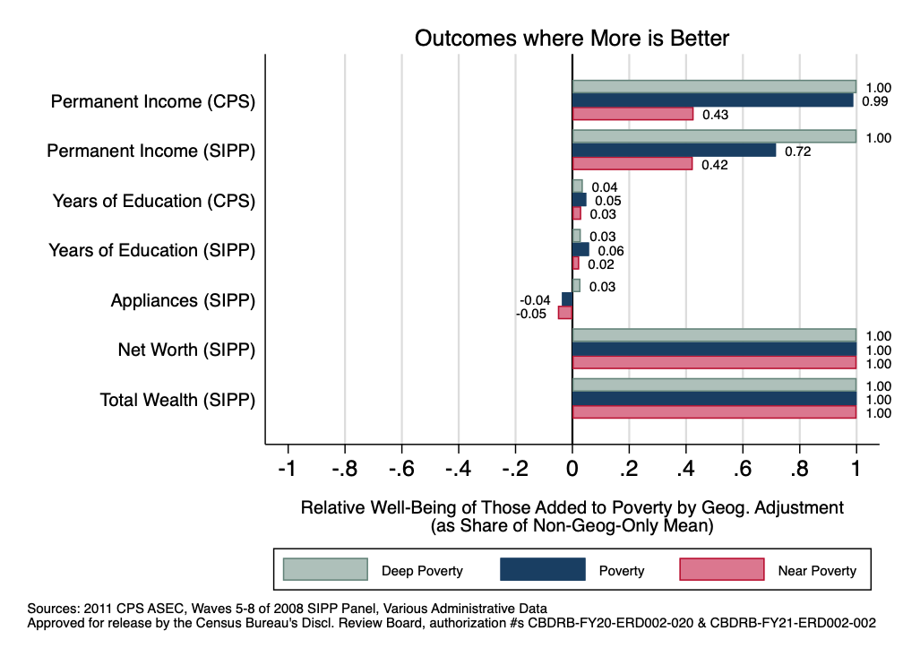
Well-Being of those Added to Poverty Relative to those Removed by RPP Adjustment, Expressed as Share, CIPM

Slide 64
Association Between Prices, Wages and Spending
Summarize elasticity table

Slide 65
Association Between Prices and Non-wage Income
Using linked survey/admin data construct the following dependent variables at the CBSA level and State
Use survey sample to entirely construct the variables, i.e. sum up weighted benefits in survey and divide by weighted population in survey
Social Security retirement and survivors per person 62+
DI per capita
Retirement income per person 60+
SNAP per capita
Housing Assistance from SPM research file per capita
SSI per capita
Using the CPS, regress these variables on our two price measures

Slide 66
Literature and Our Contributions
Previous studies have examined how geographic adjustments to poverty correlate with:
State-level material deprivation (Renwick 2018, 2019)
Mortality in Canada (Baker, Currie, & Schwandt 2019)
Education and private health ins. (Meyer & Sullivan 2012)
Our paper makes several contributions:
Examines a wider and more substantive array of well-being measures across multiple surveys and admin. data
Produces results using a more accurate and comprehensive poverty measure built from linked survey and admin. data
Compares different poverty measures on equal footing by equalizing shares of individuals in poverty under alternative measures

